Slide 1
Jermyn Borough Council Meeting
8/18/22

Slide 2
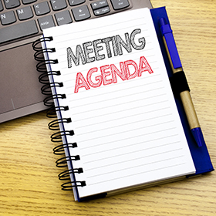
Meeting Agenda
August 18, 2022
CALL TO ORDER
PLEDGE OF ALLEGIANCE
ROLL CALL
PREVIOUS MEETING MINUTES
TREASURER REPORT/BILLS PAYABLE
CORRESPONDENCE
PUBLIC COMMENT
PROFESSIONAL REPORTS
POLICE
FIRE
EMA
SOLICITOR
CODE ENFORCEMENT
ZONING
ENGINEER
TAX COLLECTOR
MAYOR
COMMITTEE REPORTS
WASH AVE ISSUES (423-25, 427)
COMCAST ORDINANCE
500 BLOCK OF MELLOW CT
DWIGHT AVE PAVING
DPW BUILDING FLOOR GRANT
INSURANCE QUOTE INFORMATION
REGIONAL POLICE UPDATE (SEPT 26-2-4 OR 6-8 AT 911 CENTER)
GRANT ADMIN AGREEMENT FOR CFA MULTIMODAL GRANT
CFA GRANT RESOLUTION
GARBAGE CONTRACT
NEW BUSINESS

Slide 3
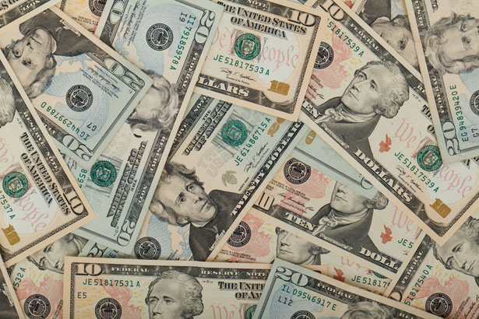
Treasurer’s report
8/18/22
ASSETS
Checking/Savings
Capital Reserve - DPW 10,727.00
Capital Reserve - Police 4,761.82
Crime Watch Fund 222.69
General Fund - Community 219,119.84
General Fund - FNB 5,810.31
Holiday Lights Fund 1,374.09

Slide 4
Treasurer’s report
Investment - General Fund 1,003.23
Investment - Liquid Fuels 33,871.65
Investment - Paving Fund 1,013.64
Investment - Recycling 5,011.94
Investment - Refuse 2,604.65
Liquid Fuels - FNB 44,258.86
Petty Cash 231.00
Recreations Fund 21,277.34
Recycling - Community 10,750.82
Refuse Checking - FNB 106,392.18
Total Checking/Savings 468,431.06

Slide 5
Treasurer’s report
200000 · Accounts Payable 2,255.86
Long Term Debt 241,056.16

Slide 6


